Slide 1
CS7015 (Deep Learning) : Lecture 5
Gradient Descent (GD), Momentum Based GD, Nesterov Accelerated GD, Stochastic GD, AdaGrad, RMSProp, Adam
Mitesh M. Khapra
Department of Computer Science and Engineering Indian Institute of Technology Madras
CS7015 (Deep Learning) : Lecture 5

Slide 2
Module 5.1: Learning Parameters : Infeasible (Guess Work)
CS7015 (Deep Learning) : Lecture 5

Slide 3
Let us look at something better than our “guess work” algorithm....
CS7015 (Deep Learning) : Lecture 5

Slide 4
Since we have only 2 points and 2 parameters (w, b) we can easily plot L (w, b) for different values of (w, b) and pick the one where L (w, b) is minimum
8 / 89
CS7015 (Deep Learning) : Lecture 5

Slide 5
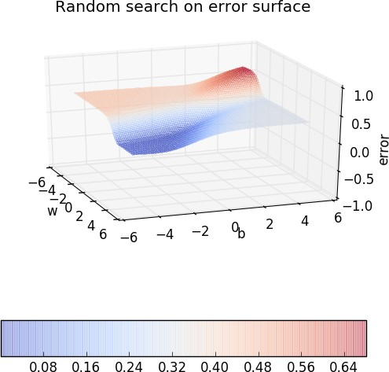
Since we have only 2 points and 2 parameters (w, b) we can easily plot L (w, b) for different values of (w, b) and pick the one where L (w, b) is minimum
8 / 89
CS7015 (Deep Learning) : Lecture 5

Slide 6
Since we have only 2 points and 2 parameters (w, b) we can easily plot L (w, b) for different values of (w, b) and pick the one where L (w, b) is minimum
But of course this becomes intract- able once you have many more data points and many more parameters !!
8 / 89
CS7015 (Deep Learning) : Lecture 5

Slide 7
Since we have only 2 points and 2 parameters (w, b) we can easily plot L (w, b) for different values of (w, b) and pick the one where L (w, b) is minimum
But of course this becomes intract- able once you have many more data points and many more parameters !!
Further, even here we have plotted the error surface only for a small range of (w, b) [from (−6, 6) and not from (− inf, inf)]
8 / 89
CS7015 (Deep Learning) : Lecture 5

Slide 8
Let us look at the geometric interpretation of our “guess work” algorithm in terms of this error surface
CS7015 (Deep Learning) : Lecture 5

Slide 9
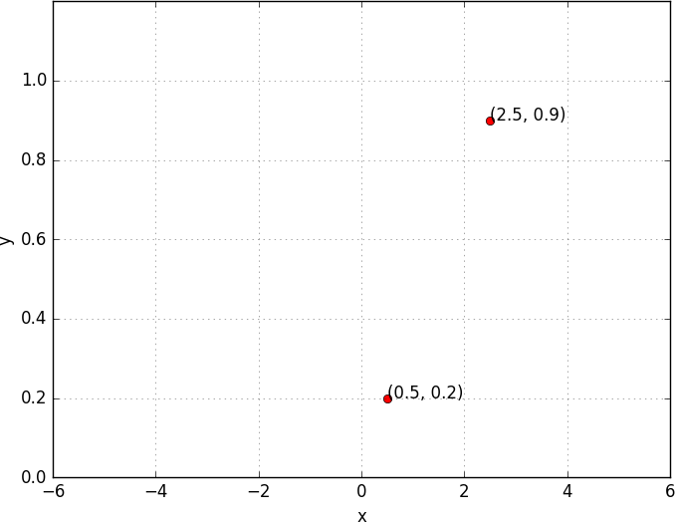
10 / 89
CS7015 (Deep Learning) : Lecture 5

Slide 10
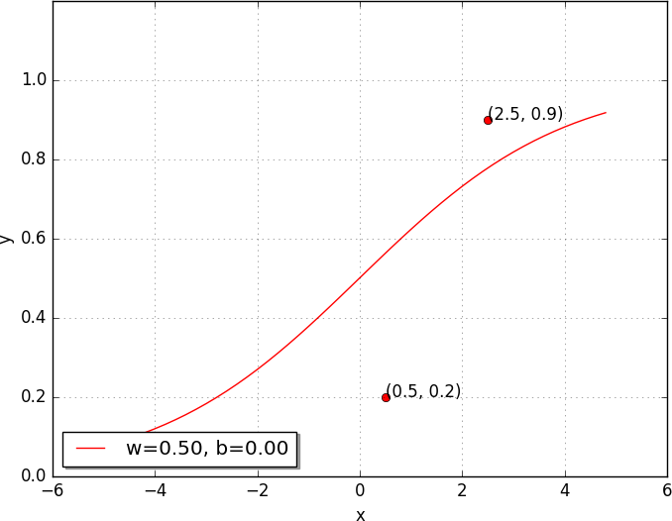

10 / 89
CS7015 (Deep Learning) : Lecture 5

Slide 11
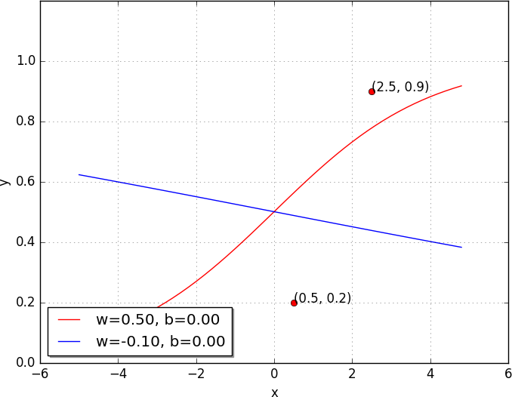

10 / 89
CS7015 (Deep Learning) : Lecture 5

Slide 12
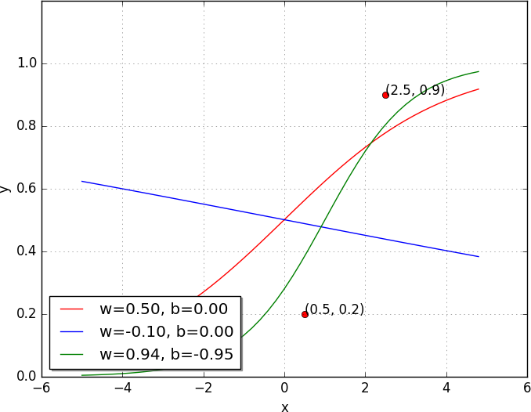

10 / 89
CS7015 (Deep Learning) : Lecture 5

Slide 13
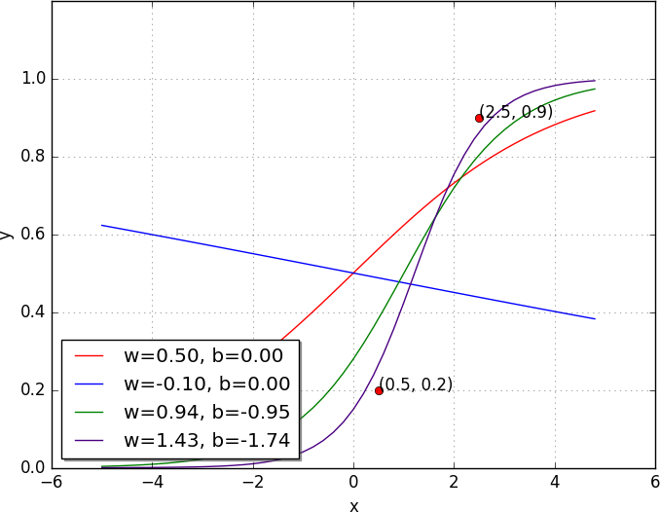

10 / 89
CS7015 (Deep Learning) : Lecture 5

Slide 14
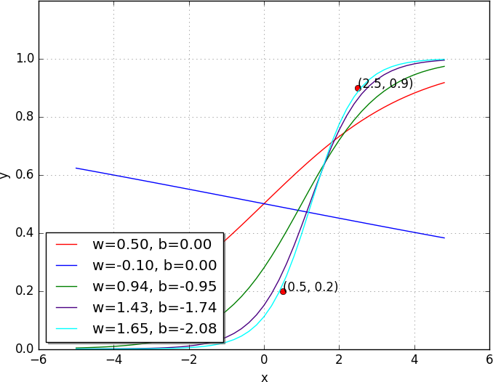

10 / 89
CS7015 (Deep Learning) : Lecture 5

Slide 15
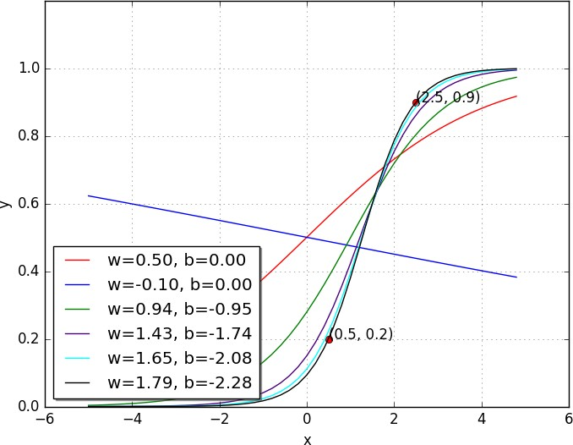
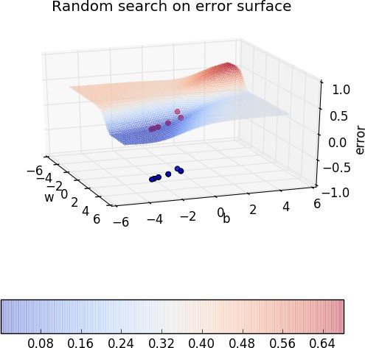
10 / 89
CS7015 (Deep Learning) : Lecture 5

Slide 16
Module 5.2: Learning Parameters : Gradient Descent
CS7015 (Deep Learning) : Lecture 5

Slide 17
Now let’s see if there is a more efficient and principled way of doing this
CS7015 (Deep Learning) : Lecture 5

Slide 18
Goal
Find a better way of traversing the error surface so that we can reach the minimum value quickly without resorting to brute force search!
CS7015 (Deep Learning) : Lecture 5

Slide 19
Gradient Descent Rule
The direction u that we intend to move in should be at 180◦ w.r.t. the gradient
17 / 89
CS7015 (Deep Learning) : Lecture 5

Slide 20
Gradient Descent Rule
The direction u that we intend to move in should be at 180◦ w.r.t. the gradient In other words, move in a direction opposite to the gradient
17 / 89
CS7015 (Deep Learning) : Lecture 5

Slide 21
Gradient Descent Rule
The direction u that we intend to move in should be at 180◦ w.r.t. the gradient
In other words, move in a direction opposite to the gradient
Parameter Update Equations
w_{t+1} = w_{t} − η∇w_{t} b_{t+1} = b_{t} − η∇b_{t}
∂L (w, b)
∂L (w, b)
∂b
where, ∇w =
, ∇b =
t
∂w
t
at w = w , b = b
at w = w , b = b
t t
t t
17 / 89
CS7015 (Deep Learning) : Lecture 5

Slide 22
Gradient Descent Rule
The direction u that we intend to move in should be at 180◦ w.r.t. the gradient
In other words, move in a direction opposite to the gradient
Parameter Update Equations
w_{t+1} = w_{t} − η∇w_{t} b_{t+1} = b_{t} − η∇b_{t}
∂L (w, b)
∂L (w, b)
∂b
where, ∇w =
, ∇b =
t
∂w
t
at w = w , b = b
at w = w , b = b
t t
t t
So we now have a more principled way of moving in the w-b plane than our “guess work” algorithm
17 / 89
CS7015 (Deep Learning) : Lecture 5

Slide 23
Let’s create an algorithm from this rule ...
18 / 89
CS7015 (Deep Learning) : Lecture 5

Slide 24
Let’s create an algorithm from this rule ...
Algorithm 1: gradient descent()
t ← 0;
max iterations ← 1000;
while t < max iterations do
w_{t+1} ← w_{t} − η∇w_{t}; b_{t+1} ← b_{t} − η∇b_{t};
end
To see this algorithm in practice let us first derive ∇w and ∇b for our toy neural network
18 / 89
CS7015 (Deep Learning) : Lecture 5

Slide 25
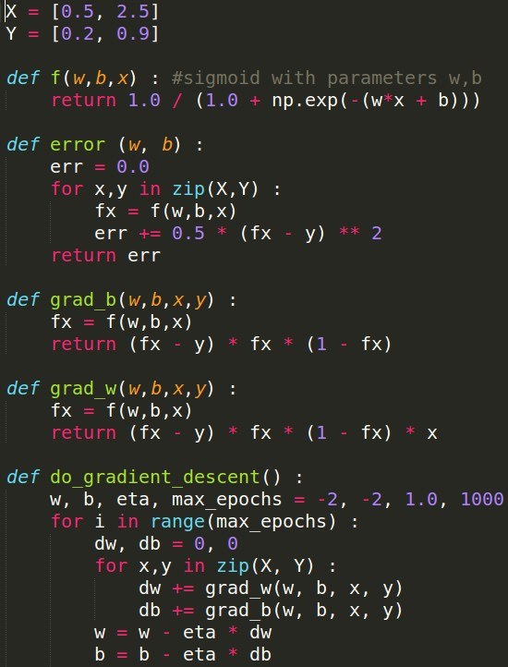
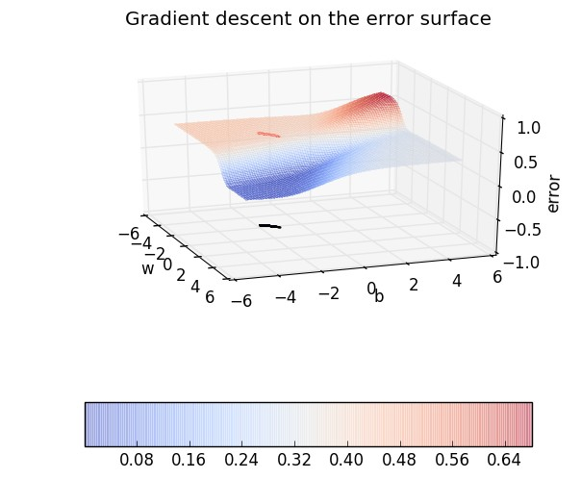
22 / 89
CS7015 (Deep Learning) : Lecture 5

Slide 26

22 / 89
CS7015 (Deep Learning) : Lecture 5

Slide 27

22 / 89
CS7015 (Deep Learning) : Lecture 5

Slide 28

22 / 89
CS7015 (Deep Learning) : Lecture 5

Slide 29

22 / 89
CS7015 (Deep Learning) : Lecture 5

Slide 30

22 / 89
CS7015 (Deep Learning) : Lecture 5

Slide 31
When the curve is steep the gradient
y
6
f (x) = x² + 1
( ^{∆y1} ) is large
∆x₁
When the curve is gentle the gradient
5
( ^{∆y2} ) is small
∆x₂
Recall that our weight updates are
4
proportional to the gradient w = w − η∇w
Hence in the areas where the curve is gentle the updates are small whereas in the areas where the curve is steep the updates are large
∆y₁
3
∆x₁
2
∆y₂
1
∆x₂
0
−1 0 1 2 3 4
x
23 / 89
CS7015 (Deep Learning) : Lecture 5

Slide 32
Let’s see what happens when we start from a differ- ent point
CS7015 (Deep Learning) : Lecture 5

Slide 33
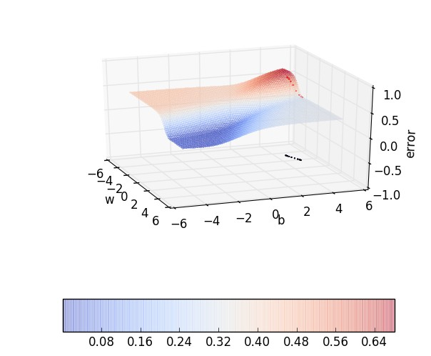
Irrespective of where we start from once we hit a surface which has a gentle slope, the progress slows down
25 / 89
CS7015 (Deep Learning) : Lecture 5

Slide 34
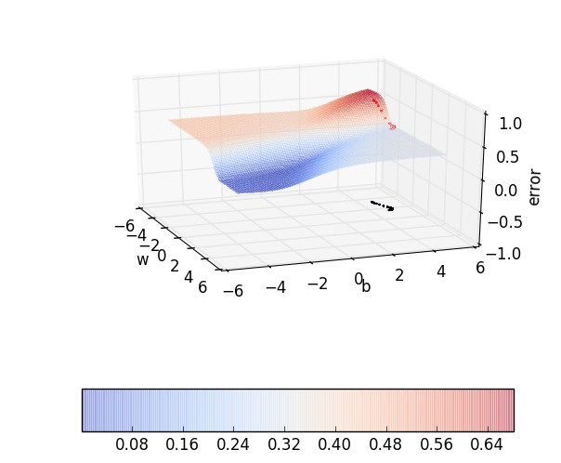
Irrespective of where we start from once we hit a surface which has a gentle slope, the progress slows down
25 / 89
CS7015 (Deep Learning) : Lecture 5

Slide 35
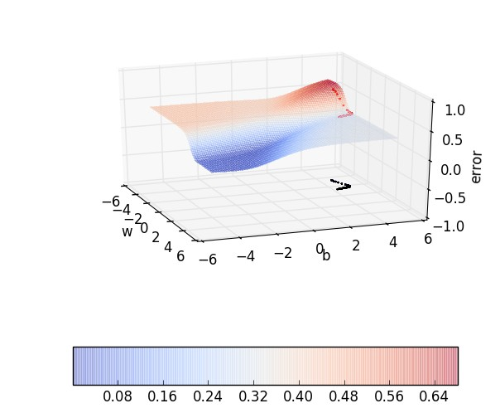
Irrespective of where we start from once we hit a surface which has a gentle slope, the progress slows down
25 / 89
CS7015 (Deep Learning) : Lecture 5

Slide 36

Irrespective of where we start from once we hit a surface which has a gentle slope, the progress slows down
25 / 89
CS7015 (Deep Learning) : Lecture 5

Slide 37

Irrespective of where we start from once we hit a surface which has a gentle slope, the progress slows down
25 / 89
CS7015 (Deep Learning) : Lecture 5

Slide 38

Irrespective of where we start from once we hit a surface which has a gentle slope, the progress slows down
25 / 89
CS7015 (Deep Learning) : Lecture 5

Slide 39

Irrespective of where we start from once we hit a surface which has a gentle slope, the progress slows down
25 / 89
CS7015 (Deep Learning) : Lecture 5

Slide 40

Irrespective of where we start from once we hit a surface which has a gentle slope, the progress slows down
25 / 89
CS7015 (Deep Learning) : Lecture 5

Slide 41
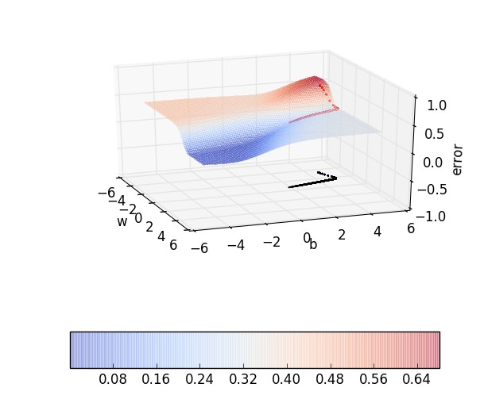
Irrespective of where we start from once we hit a surface which has a gentle slope, the progress slows down
25 / 89
CS7015 (Deep Learning) : Lecture 5

Slide 42

Irrespective of where we start from once we hit a surface which has a gentle slope, the progress slows down
25 / 89
CS7015 (Deep Learning) : Lecture 5

Slide 43

Irrespective of where we start from once we hit a surface which has a gentle slope, the progress slows down
25 / 89
CS7015 (Deep Learning) : Lecture 5

Slide 44
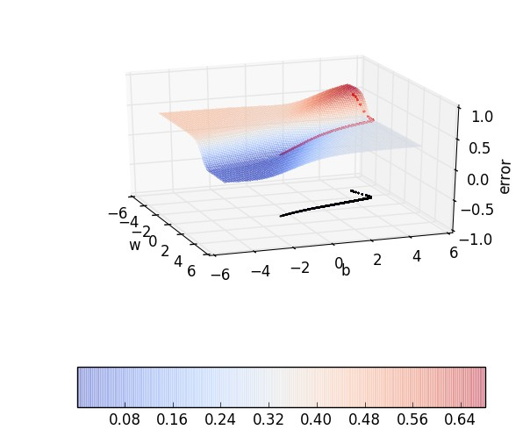
Irrespective of where we start from once we hit a surface which has a gentle slope, the progress slows down
25 / 89
CS7015 (Deep Learning) : Lecture 5

Slide 45

Irrespective of where we start from once we hit a surface which has a gentle slope, the progress slows down
25 / 89
CS7015 (Deep Learning) : Lecture 5

Slide 46
Module 5.3 : Contours
CS7015 (Deep Learning) : Lecture 5

Slide 47
Visualizing things in 3d can sometimes become a bit cumbersome
Can we do a 2d visualization of this traversal along
the error surface
Yes, let’s take a look at something known as con- tours
27 / 89
CS7015 (Deep Learning) : Lecture 5

Slide 48
Suppose I take horizontal slices of this error surface at regular intervals along the vertical axis
How would this look from the top- view ?
error
θ
Figure: Front view of a 3d error surface
Mitesh M. Khapra
28 / 89
CS7015 (Deep Learning) : Lecture 5

Slide 49
error
A small distance between the con- tours indicates a steep slope along that direction
A large distance between the contours indicates a gentle slope along that dir- ection
θ
Figure: Front view of a 3d error surface
Mitesh M. Khapra
28 / 89
CS7015 (Deep Learning) : Lecture 5

Slide 50
Just to ensure that we understand this properly let us do a few exercises ...
CS7015 (Deep Learning) : Lecture 5

Slide 51
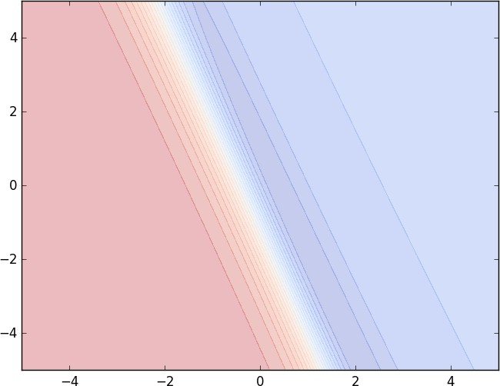
Guess the 3d surface
30 / 89
CS7015 (Deep Learning) : Lecture 5

Slide 52
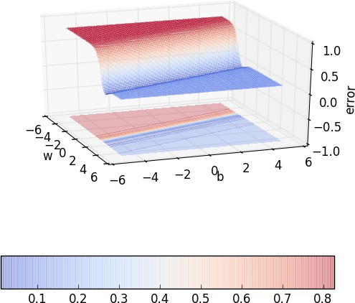
Guess the 3d surface
30 / 89
CS7015 (Deep Learning) : Lecture 5

Slide 53
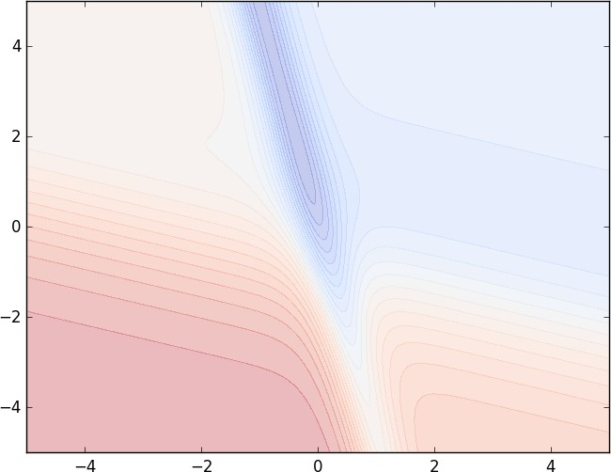
Guess the 3d surface
30 / 89
CS7015 (Deep Learning) : Lecture 5

Slide 54
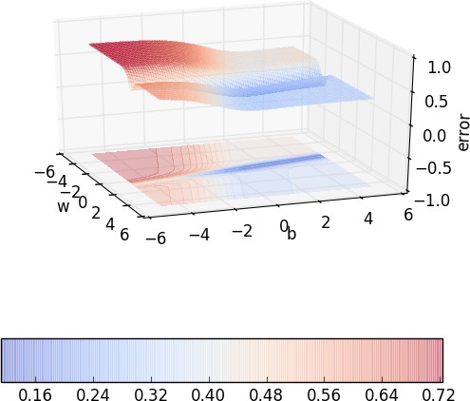
Guess the 3d surface
30 / 89
CS7015 (Deep Learning) : Lecture 5

Slide 55
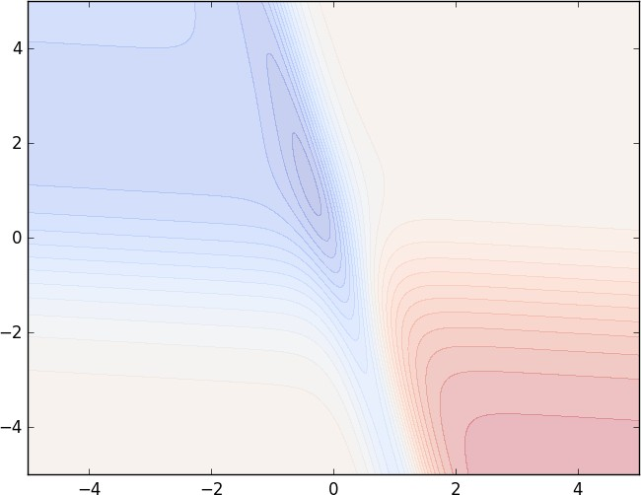
Guess the 3d surface
30 / 89
CS7015 (Deep Learning) : Lecture 5

Slide 56
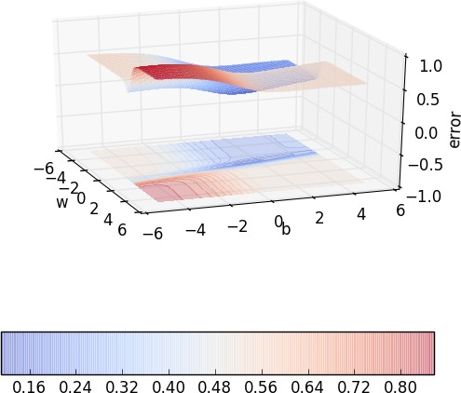
Guess the 3d surface
30 / 89
CS7015 (Deep Learning) : Lecture 5

Slide 57
Module 5.4 : Momentum based Gradient Descent
CS7015 (Deep Learning) : Lecture 5

Slide 58
Some observations about gradient descent
It takes a lot of time to navigate regions having a gentle slope This is because the gradient in these regions is very small Can we do something better ?
Yes, let’s take a look at ‘Momentum based gradient descent’
35 / 89
CS7015 (Deep Learning) : Lecture 5

Slide 59
Intuition
If I am repeatedly being asked to move in the same direction then I should probably gain some confidence and start taking bigger steps in that direction
Just as a ball gains momentum while rolling down a slope
Update rule for momentum based gradient descent
update_{t} = γ · update_{t−1} + η∇w_{t} w_{t+1} = w_{t} − update_{t}
In addition to the current update, also look at the history of updates.
36 / 89
CS7015 (Deep Learning) : Lecture 5

Slide 60
update_{t} = γ · update_{t−1} + η∇w_{t} w_{t+1} = w_{t} − update_{t}
update₀ = 0
update₁ = γ · update₀ + η∇w₁ = η∇w₁
update₂ = γ · update₁ + η∇w₂ = γ · η∇w₁ + η∇w₂
update₃ = γ · update₂ + η∇w₃ = γ(γ · η∇w₁ + η∇w₂) + η∇w₃
2
= γ · update₂ + η∇w₃ = γ · η∇w₁ + γ · η∇w₂ + η∇w₃
37 / 89
CS7015 (Deep Learning) : Lecture 5

Slide 61
update_{t} = γ · update_{t−1} + η∇w_{t} w_{t+1} = w_{t} − update_{t}
update₀ = 0
update₁ = γ · update₀ + η∇w₁ = η∇w₁
update₂ = γ · update₁ + η∇w₂ = γ · η∇w₁ + η∇w₂
update₃ = γ · update₂ + η∇w₃ = γ(γ · η∇w₁ + η∇w₂) + η∇w₃
2
= γ · update₂ + η∇w₃ = γ · η∇w₁ + γ · η∇w₂ + η∇w₃
3 2
update₄ = γ · update₃ + η∇w₄ = γ · η∇w₁ + γ · η∇w₂ + γ · η∇w₃ + η∇w₄
37 / 89
CS7015 (Deep Learning) : Lecture 5

Slide 62
update_{t} = γ · update_{t−1} + η∇w_{t} w_{t+1} = w_{t} − update_{t}
update₀ = 0
update₁ = γ · update₀ + η∇w₁ = η∇w₁
update₂ = γ · update₁ + η∇w₂ = γ · η∇w₁ + η∇w₂
update₃ = γ · update₂ + η∇w₃ = γ(γ · η∇w₁ + η∇w₂) + η∇w₃
2
= γ · update₂ + η∇w₃ = γ · η∇w₁ + γ · η∇w₂ + η∇w₃
3 2
update₄ = γ · update₃ + η∇w₄ = γ · η∇w₁ + γ · η∇w₂ + γ · η∇w₃ + η∇w₄
.
t−1 t−2
update_{t} = γ · update_{t−1} + η∇w_{t} = γ · η∇w₁ + γ · η∇w₁ + ... + η∇w_{t}
.
37 / 89
CS7015 (Deep Learning) : Lecture 5

Slide 63
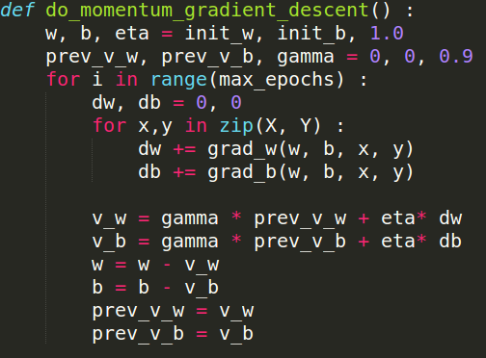
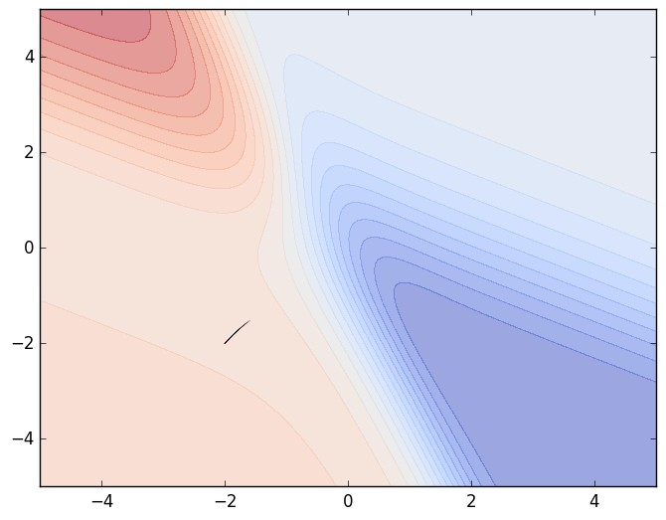
b
w
38 / 89
CS7015 (Deep Learning) : Lecture 5

Slide 64

b
w
38 / 89
CS7015 (Deep Learning) : Lecture 5

Slide 65

b
w
38 / 89
CS7015 (Deep Learning) : Lecture 5

Slide 66

b
w
38 / 89
CS7015 (Deep Learning) : Lecture 5

Slide 67

b
w
38 / 89
CS7015 (Deep Learning) : Lecture 5

Slide 68

b
w
38 / 89
CS7015 (Deep Learning) : Lecture 5

Slide 69

b
w
38 / 89
CS7015 (Deep Learning) : Lecture 5

Slide 70

b
w
38 / 89
CS7015 (Deep Learning) : Lecture 5

Slide 71

b
w
38 / 89
CS7015 (Deep Learning) : Lecture 5

Slide 72

b
w
38 / 89
CS7015 (Deep Learning) : Lecture 5

Slide 73

b
w
38 / 89
CS7015 (Deep Learning) : Lecture 5

Slide 74
Some observations and questions
Even in the regions having gentle slopes, momentum based gradient descent is able to take large steps because the momentum carries it along
Is moving fast always good? Would there be a situation where momentum would cause us to run pass our goal?
Let us change our input data so that we end up with a different error surface and then see what happens ...
39 / 89
CS7015 (Deep Learning) : Lecture 5

Slide 75
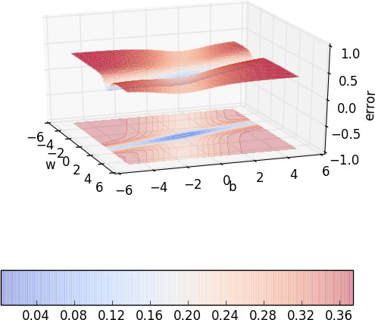
In this case, the error is high on either side of the minima valley
Could momentum be detrimental in such cases... let’s see....
40 / 89
CS7015 (Deep Learning) : Lecture 5

Slide 76
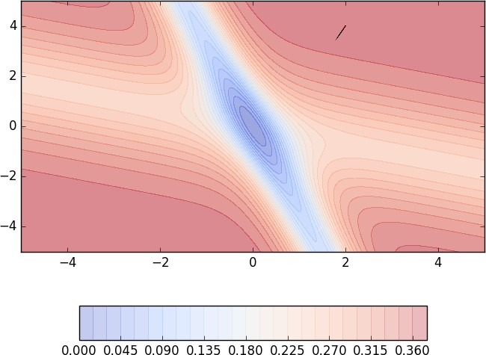
b
w
41 / 89
CS7015 (Deep Learning) : Lecture 5

Slide 77

b
w
41 / 89
CS7015 (Deep Learning) : Lecture 5

Slide 78

b
w
41 / 89
CS7015 (Deep Learning) : Lecture 5

Slide 79

b
w
41 / 89
CS7015 (Deep Learning) : Lecture 5

Slide 80

b
w
41 / 89
CS7015 (Deep Learning) : Lecture 5

Slide 81

b
w
41 / 89
CS7015 (Deep Learning) : Lecture 5

Slide 82
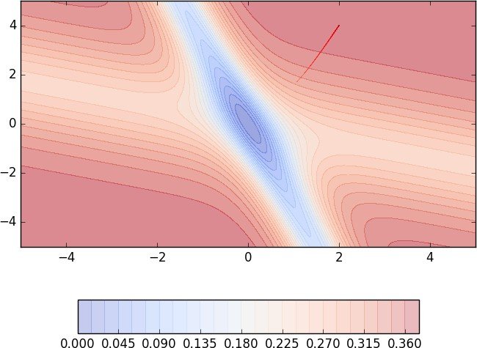
b
w
41 / 89
CS7015 (Deep Learning) : Lecture 5

Slide 83

b
w
41 / 89
CS7015 (Deep Learning) : Lecture 5

Slide 84
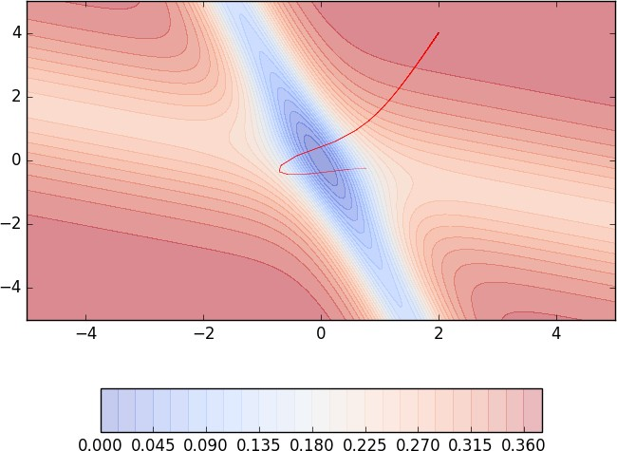
b
w
41 / 89
CS7015 (Deep Learning) : Lecture 5

Slide 85

b
w
41 / 89
CS7015 (Deep Learning) : Lecture 5

Slide 86

b
w
41 / 89
CS7015 (Deep Learning) : Lecture 5

Slide 87

b
w
41 / 89
CS7015 (Deep Learning) : Lecture 5

Slide 88

b
w
41 / 89
CS7015 (Deep Learning) : Lecture 5

Slide 89

b
w
41 / 89
CS7015 (Deep Learning) : Lecture 5

Slide 90

Momentum based gradient descent oscillates in and out of the minima valley as the momentum carries it out of the valley
b
w
41 / 89
CS7015 (Deep Learning) : Lecture 5

Slide 91

Momentum based gradient descent oscillates in and out of the minima valley as the momentum carries it out of the valley
Takes a lot of u-turns before finally converging
Despite these u-turns it still con- verges faster than vanilla gradient descent
After 100 iterations momentum based method has reached an error of 0.00001 whereas vanilla gradient des- cent is still stuck at an error of 0.36
b
w
41 / 89
CS7015 (Deep Learning) : Lecture 5

Slide 92
Module 5.5 : Nesterov Accelerated Gradient Descent
CS7015 (Deep Learning) : Lecture 5

Slide 93
Intuition
Look before you leap
Recall that update_{t} = γ · update_{t−1} + η∇w_{t}
So we know that we are going to move by at least by γ · update_{t−1} and then a bit more by η∇w_{t}
Why not calculate the gradient (∇w_{look ahead}) at this partially updated value of w (w_{look ahead} = w_{t} −γ · update_{t−1}) instead of calculating it using the current value w_{t}
Update rule for NAG
w_{look ahead} = w_{t} − γ · update_{t−1}
update_{t} = γ · update_{t−1} + η∇w_{look ahead}
w_{t+1} = w_{t} − update_{t}
We will have similar update rule for b_{t}
46 / 89
CS7015 (Deep Learning) : Lecture 5

Slide 94
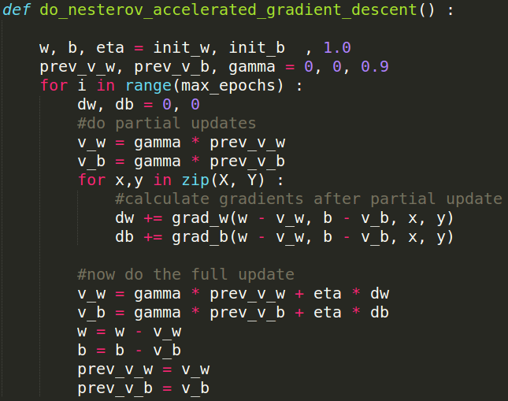
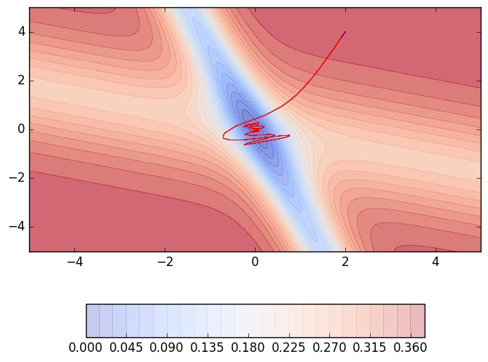
b
w
47 / 89
CS7015 (Deep Learning) : Lecture 5

Slide 95

b
w
47 / 89
CS7015 (Deep Learning) : Lecture 5

Slide 96

b
w
47 / 89
CS7015 (Deep Learning) : Lecture 5

Slide 97

b
w
47 / 89
CS7015 (Deep Learning) : Lecture 5

Slide 98

b
w
47 / 89
CS7015 (Deep Learning) : Lecture 5

Slide 99

b
w
47 / 89
CS7015 (Deep Learning) : Lecture 5

Slide 100

b
w
47 / 89
CS7015 (Deep Learning) : Lecture 5

Slide 101

b
w
47 / 89
CS7015 (Deep Learning) : Lecture 5

Slide 102

b
w
47 / 89
CS7015 (Deep Learning) : Lecture 5

Slide 103
Observations about NAG
Looking ahead helps NAG in correcting its course quicker than momentum based gradient descent
Hence the oscillations are smaller and the chances of escaping the minima valley also smaller
49 / 89
CS7015 (Deep Learning) : Lecture 5

Slide 104
Module 5.6 : Stochastic And Mini-Batch Gradient Descent
CS7015 (Deep Learning) : Lecture 5

Slide 105
Let’s digress a bit and talk about the stochastic version of these algorithms...
CS7015 (Deep Learning) : Lecture 5

Slide 106
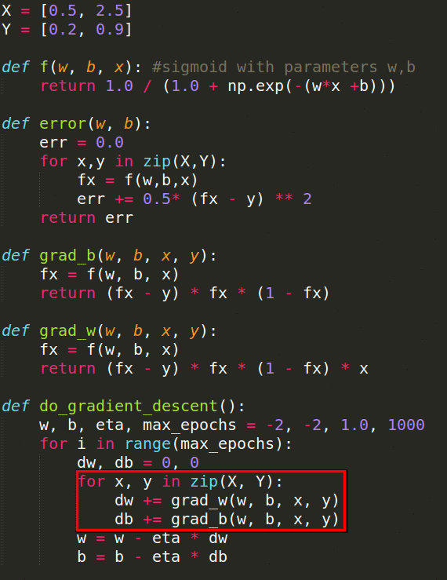
Notice that the algorithm goes over the entire data once before updating the parameters
Why? Because this is the true gradient of the loss as derived earlier (sum of the gradients of the losses corresponding to each data point)
No approximation. Hence, theoretical guaran- tees hold (in other words each step guarantees that the loss will decrease)
What’s the flipside? Imagine we have a mil- lion points in the training data. To make 1 update to w, b the algorithm makes a million calculations. Obviously very slow!!
Can we do something better ? Yes, let’s look at stochastic gradient descent
52 / 89
CS7015 (Deep Learning) : Lecture 5

Slide 107
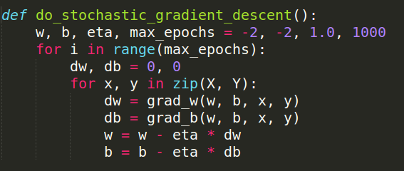
Notice that the algorithm updates the para- meters for every single data point
Now if we have a million data points we will make a million updates in each epoch (1 epoch
= 1 pass over the data; 1 step = 1 update)
What is the flipside ? It is an approximate (rather stochastic) gradient
No guarantee that each step will decrease the loss
Let’s see this algorithm in action when we have a few data points
Stochastic because we are estimating the total gradi- ent based on a single data point. Almost like tossing a coin only once and estimat- ing P(heads).
53 / 89
CS7015 (Deep Learning) : Lecture 5

Slide 108
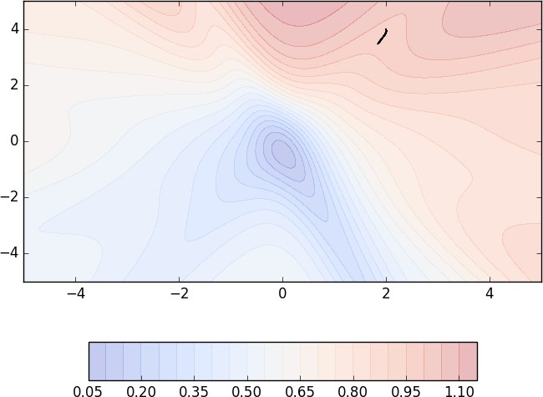
b
w
54 / 89
CS7015 (Deep Learning) : Lecture 5

Slide 109
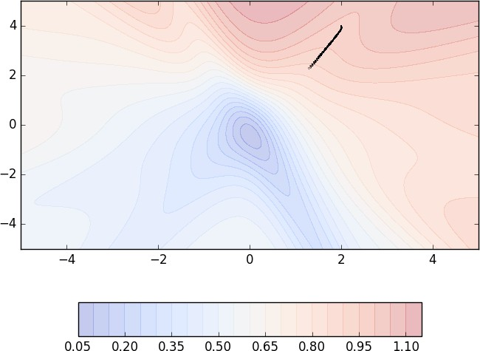
b
w
54 / 89
CS7015 (Deep Learning) : Lecture 5

Slide 110
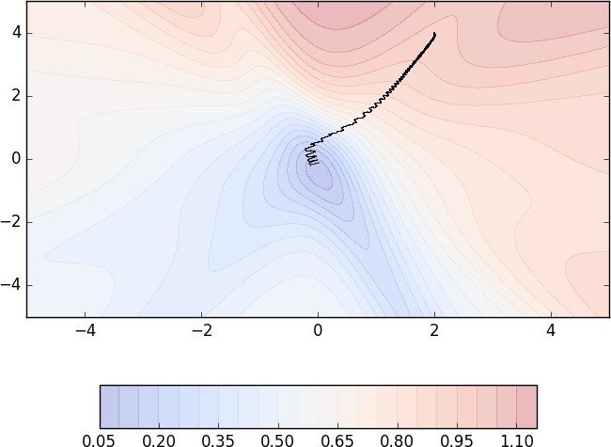
b
w
55 / 89
CS7015 (Deep Learning) : Lecture 5

Slide 111

b
w
55 / 89
CS7015 (Deep Learning) : Lecture 5

Slide 112

We see many oscillations. Why ? Be- cause we are making greedy decisions.
Each point is trying to push the para- meters in a direction most favorable to it (without being aware of how this af- fects other points)
A parameter update which is locally fa- vorable to one point may harm other points (its almost as if the data points are competing with each other)
Can we reduce the oscillations by im- proving our stochastic estimates of the gradient (currently estimated from just 1 data point at a time)
Yes, let’s look at mini-batch gradient descent
b
w
55 / 89
CS7015 (Deep Learning) : Lecture 5

Slide 113
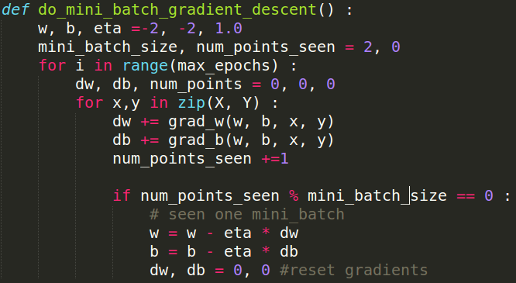
Notice that the algorithm up- dates the parameters after it sees mini batch size number of data points
The stochastic estimates are now slightly better
Let’s see this algorithm in action when we have k = 2
56 / 89
CS7015 (Deep Learning) : Lecture 5

Slide 114
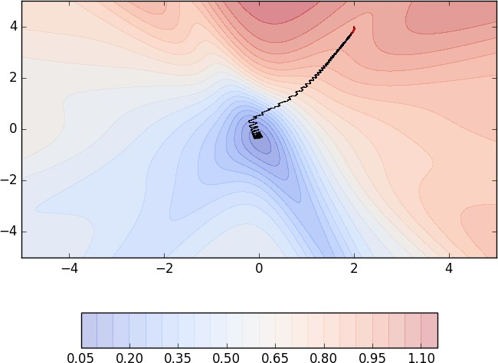
b
w
57 / 89
CS7015 (Deep Learning) : Lecture 5

Slide 115

b
w
58 / 89
CS7015 (Deep Learning) : Lecture 5

Slide 116
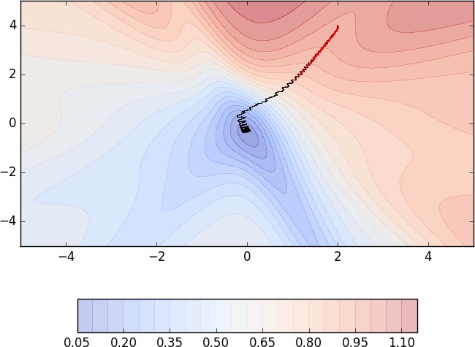
b
w
58 / 89
CS7015 (Deep Learning) : Lecture 5

Slide 117

b
w
58 / 89
CS7015 (Deep Learning) : Lecture 5

Slide 118
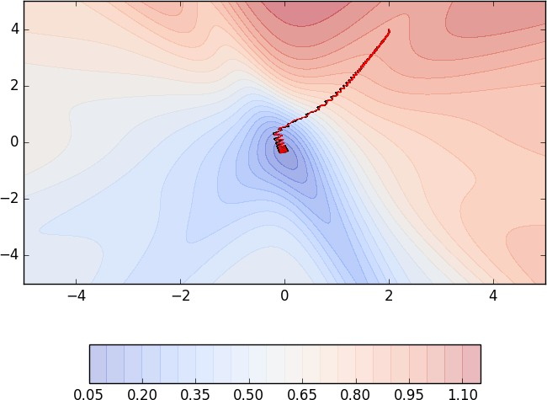
Even with a batch size of k=2 the oscilla- tions have reduced slightly. Why ?
Because we now have slightly better es- timates of the gradient
b
w
58 / 89
CS7015 (Deep Learning) : Lecture 5

Slide 119
Even with a batch size of k=2 the oscilla- tions have reduced slightly. Why ?
Because we now have slightly better es- timates of the gradient [analogy: we are now tossing the coin k=2 times to estim- ate P(heads)]
The higher the value of k the more accurate are the estimates
In practice, typical values of k are 16, 32, 64
Of course, there are still oscillations and they will always be there as long as we are using an approximate gradient as opposed to the true gradient
b
w
58 / 89
CS7015 (Deep Learning) : Lecture 5

Slide 120
Some things to remember ....
1 epoch = one pass over the entire data 1 step = one update of the parameters N = number of data points
B = Mini batch size
Algorithm
# of steps in 1 epoch
Vanilla (Batch) Gradient Descent Stochastic Gradient Descent Mini-Batch Gradient Descent
1
N
N B
59 / 89
CS7015 (Deep Learning) : Lecture 5

Slide 121
Similarly, we can have stochastic versions of Momentum based gradient descent and Nesterov accelerated based gradient descent
CS7015 (Deep Learning) : Lecture 5

Slide 122
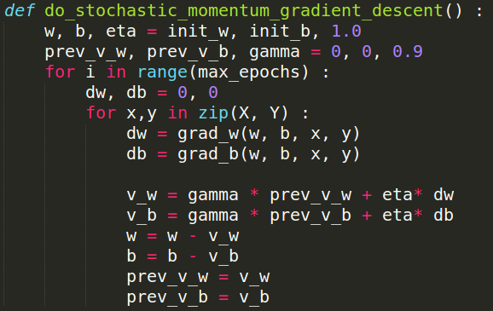
CS7015 (Deep Learning) : Lecture 5

Slide 123
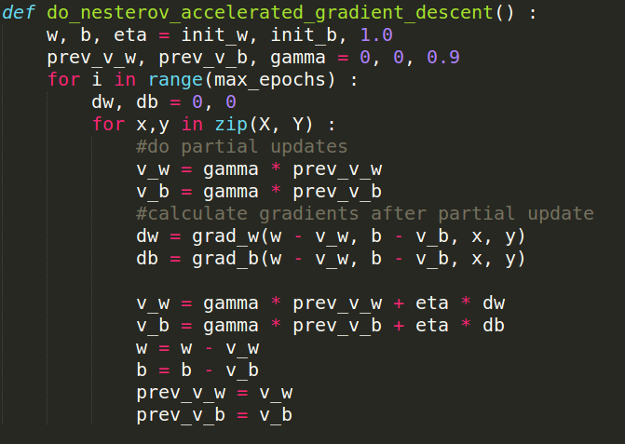
CS7015 (Deep Learning) : Lecture 5

Slide 124

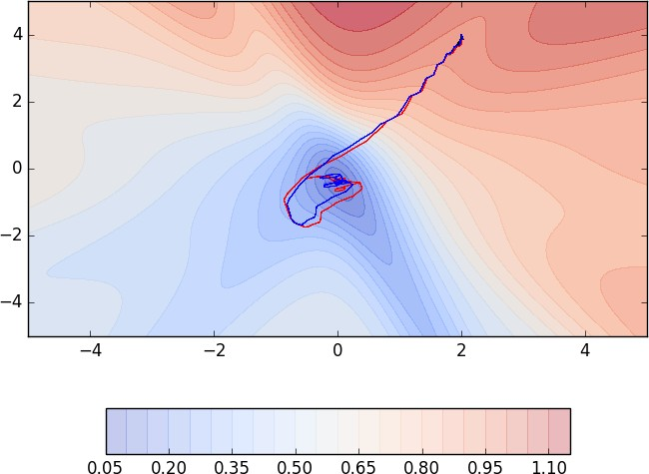
While the stochastic versions of both Mo- mentum [red] and NAG [blue] exhibit oscilla- tions the relative advantage of NAG over Mo- mentum still holds (i.e., NAG takes relatively shorter u-turns)
Further both of them are faster than stochastic gradient descent
b
w
b
w
63 / 89
CS7015 (Deep Learning) : Lecture 5

Slide 125
While the stochastic versions of both Mo- mentum [red] and NAG [blue] exhibit oscilla- tions the relative advantage of NAG over Mo- mentum still holds (i.e., NAG takes relatively shorter u-turns)
Further both of them are faster than stochastic gradient descent (after 60 steps, stochastic gradient descent [black - top figure] still exhibits a very high error whereas NAG and Momentum are close to convergence)
b
w
b
w
63 / 89
CS7015 (Deep Learning) : Lecture 5

Slide 126
And, of course, you can also have the mini batch version of Momentum and NAG...
64 / 89
CS7015 (Deep Learning) : Lecture 5

Slide 127
Module 5.7 : Tips for Adjusting learning Rate and Momentum
CS7015 (Deep Learning) : Lecture 5

Slide 128
Before moving on to advanced optimization algorithms let us revisit the problem of learning rate in gradient descent
CS7015 (Deep Learning) : Lecture 5

Slide 129
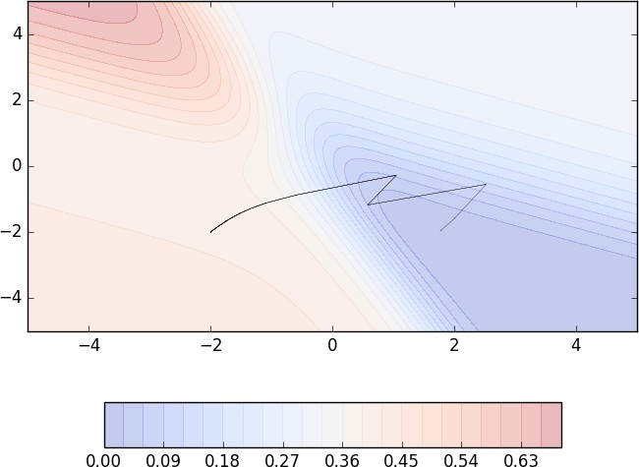
One could argue that we could have solved the problem of navigating gentle slopes by setting the learning rate high (i.e., blow up the small gradient by multiplying it with a large η)
b
Let us see what happens if we set the learn- ing rate to 10
w
67 / 89
CS7015 (Deep Learning) : Lecture 5

Slide 130
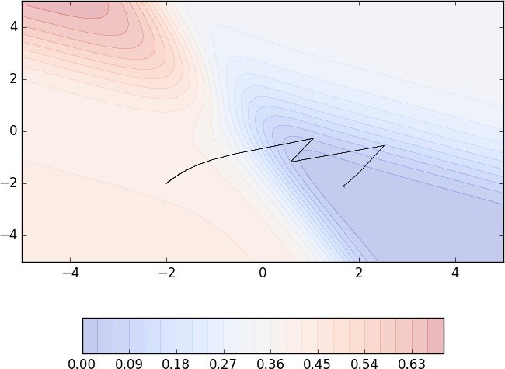
One could argue that we could have solved the problem of navigating gentle slopes by setting the learning rate high (i.e., blow up the small gradient by multiplying it with a large η)
b
Let us see what happens if we set the learn- ing rate to 10
w
67 / 89
CS7015 (Deep Learning) : Lecture 5

Slide 131

One could argue that we could have solved the problem of navigating gentle slopes by setting the learning rate high (i.e., blow up the small gradient by multiplying it with a large η)
b
Let us see what happens if we set the learn- ing rate to 10
w
67 / 89
CS7015 (Deep Learning) : Lecture 5

Slide 132

One could argue that we could have solved the problem of navigating gentle slopes by setting the learning rate high (i.e., blow up the small gradient by multiplying it with a large η)
b
Let us see what happens if we set the learn- ing rate to 10
w
67 / 89
CS7015 (Deep Learning) : Lecture 5

Slide 133

One could argue that we could have solved the problem of navigating gentle slopes by setting the learning rate high (i.e., blow up the small gradient by multiplying it with a large η)
b
Let us see what happens if we set the learn- ing rate to 10
On the regions which have a steep slope, the already large gradient blows up further
It would be good to have a learning rate which could adjust to the gradient ...
w
67 / 89
CS7015 (Deep Learning) : Lecture 5

Slide 134

One could argue that we could have solved the problem of navigating gentle slopes by setting the learning rate high (i.e., blow up the small gradient by multiplying it with a large η)
b
Let us see what happens if we set the learn- ing rate to 10
On the regions which have a steep slope, the already large gradient blows up further
It would be good to have a learning rate which could adjust to the gradient ... we will see a few such algorithms soon
w
67 / 89
CS7015 (Deep Learning) : Lecture 5

Slide 135
Tips for initial learning rate ?
Tune learning rate [Try different values on a log scale: 0.0001, 0.001, 0.01, 0.1. 1.0]
Run a few epochs with each of these and figure out a learning rate which works best
Now do a finer search around this value [for example, if the best learning rate was 0.1 then now try some values around it: 0.05, 0.2, 0.3]
Disclaimer: these are just heuristics ... no clear winner strategy
68 / 89
CS7015 (Deep Learning) : Lecture 5

Slide 136
Tips for annealing learning rate
Step Decay:
Halve the learning rate after every 5 epochs or
Halve the learning rate after an epoch if the validation error is more than what it was at the end of the previous epoch
69 / 89
CS7015 (Deep Learning) : Lecture 5

Slide 137
Tips for annealing learning rate
Step Decay:
Halve the learning rate after every 5 epochs or
Halve the learning rate after an epoch if the validation error is more than what it was at the end of the previous epoch
Exponential Decay: η = η^{−kt} where η₀ and k are hyperparameters and t is
0
the step number
69 / 89
CS7015 (Deep Learning) : Lecture 5

Slide 138
Tips for annealing learning rate
Step Decay:
Halve the learning rate after every 5 epochs or
Halve the learning rate after an epoch if the validation error is more than what it was at the end of the previous epoch
Exponential Decay: η = η^{−kt} where η₀ and k are hyperparameters and t is
0
the step number
1/t Decay: η = ^{η0} where η₀ and k are hyperparameters and t is the step
1+kt
number
69 / 89
CS7015 (Deep Learning) : Lecture 5

Slide 139
Tips for momentum
The following schedule was suggested by Sutskever et. al., 2013
_{γt = min(1 − 2}−1−log₂(lt/250J+1)_{, γmax)}
where, γ_{max} was chosen from {0.999, 0.995, 0.99, 0.9, 0}
CS7015 (Deep Learning) : Lecture 5

Slide 140
Module 5.8 : Line Search
CS7015 (Deep Learning) : Lecture 5

Slide 141
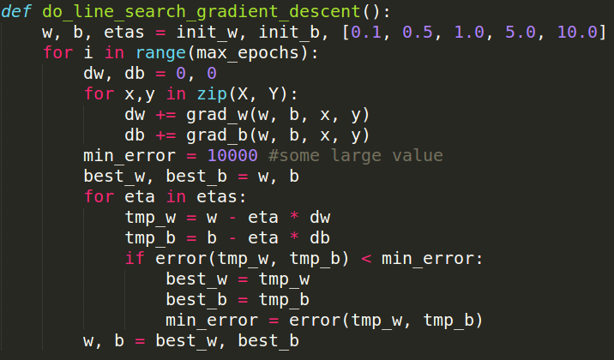
In practice, often a line search is done to find a relatively better value of η
Update w using different values of η
Now retain that updated value of w
which gives the lowest loss
Esentially at each step we are trying to use the best η value from the avail- able choices
What’s the flipside? We are doing many more computations in each step
We will come back to this when we talk about second order optimization methods
73 / 89
CS7015 (Deep Learning) : Lecture 5

Slide 142

Let us see line search in action
b
w
74 / 89
CS7015 (Deep Learning) : Lecture 5

Slide 143
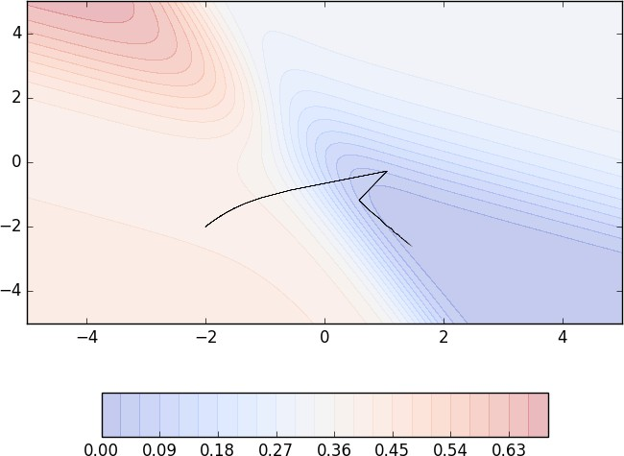
Let us see line search in action
b
w
74 / 89
CS7015 (Deep Learning) : Lecture 5

Slide 144

Let us see line search in action
b
w
74 / 89
CS7015 (Deep Learning) : Lecture 5

Slide 145

Let us see line search in action
b
w
74 / 89
CS7015 (Deep Learning) : Lecture 5

Slide 146

Convergence is faster than vanilla gradient descent
Let us see line search in action
b
w
74 / 89
CS7015 (Deep Learning) : Lecture 5

Slide 147
Module 5.9 : Gradient Descent with Adaptive Learning Rate
CS7015 (Deep Learning) : Lecture 5

Slide 148
_{x}1
_{x}2
_{x}3
σ
y
_{x}4
1
y = f (x) = ¹
_{1+e}−(w·x+b)
1 2 3 4
x = {x , x , x , x }
1 2 3 4
w = {w , w , w , w }
76 / 89
CS7015 (Deep Learning) : Lecture 5

Slide 149
Given this network, it should be easy to see that given a single point (x, y)...
_{x}1
_{x}2
1 1
∇w = (f (x) − y) ∗ f (x) ∗ (1 − f (x)) ∗ x
_{x}3
σ
y
2 2
∇w = (f (x) − y) ∗ f (x) ∗ (1 − f (x)) ∗ x ... so on
If there are n points, we can just sum the gradients over
_{x}4
all the n points to get the total gradient
1
y = f (x) = ¹
_{1+e}−(w·x+b)
1 2 3 4
x = {x , x , x , x }
1 2 3 4
w = {w , w , w , w }
76 / 89
CS7015 (Deep Learning) : Lecture 5

Slide 150
Given this network, it should be easy to see that given a single point (x, y)...
_{x}1
_{x}2
1 1
∇w = (f (x) − y) ∗ f (x) ∗ (1 − f (x)) ∗ x
_{x}3
σ
y
2 2
∇w = (f (x) − y) ∗ f (x) ∗ (1 − f (x)) ∗ x ... so on
If there are n points, we can just sum the gradients over
_{x}4
all the n points to get the total gradient
What happens if the feature x² is very sparse? (i.e., if its value is 0 for most inputs)
1
2 2
∇w will be 0 for most inputs (see formula) and hence w
1
will not get enough updates
If x² happens to be sparse as well as important we would want to take the updates to w² more seriously
^{y = f (x) =} _{1+e}−(w·x+b)
1 2 3 4
x = {x , x , x , x }
1 2 3 4
w = {w , w , w , w }
76 / 89
CS7015 (Deep Learning) : Lecture 5

Slide 151
Given this network, it should be easy to see that given a single point (x, y)...
_{x}1
_{x}2
1 1
∇w = (f (x) − y) ∗ f (x) ∗ (1 − f (x)) ∗ x
_{x}3
σ
y
2 2
∇w = (f (x) − y) ∗ f (x) ∗ (1 − f (x)) ∗ x ... so on
If there are n points, we can just sum the gradients over
_{x}4
all the n points to get the total gradient
What happens if the feature x² is very sparse? (i.e., if its value is 0 for most inputs)
1
2 2
∇w will be 0 for most inputs (see formula) and hence w
1
will not get enough updates
If x² happens to be sparse as well as important we would want to take the updates to w² more seriously
Can we have a different learning rate for each parameter which takes care of the frequency of features ?
^{y = f (x) =} _{1+e}−(w·x+b)
1 2 3 4
x = {x , x , x , x }
1 2 3 4
w = {w , w , w , w }
76 / 89
CS7015 (Deep Learning) : Lecture 5

Slide 152
Intuition
Decay the learning rate for parameters in proportion to their update history (more updates means more decay)
Update rule for Adagrad
v_{t} = v_{t−1} + (∇w_{t})²
η
w = w − √
∗ ∇w
t+1 t
v + E
t
t
... and a similar set of equations for b_{t}
77 / 89
CS7015 (Deep Learning) : Lecture 5

Slide 153
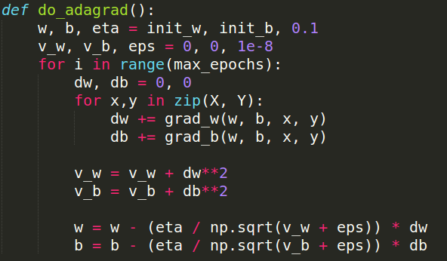
To see this in action we need to first create some data where one of the features is sparse
How would we do this in our toy network ? Take some time to think about it
Well, our network has just two parameters (w and b). Of these, the input/feature corres- ponding to b is always on (so can’t really make it sparse)
The only option is to make x sparse
Solution: We created 100 random (x, y) pairs and then for roughly 80% of these pairs we set x to 0 thereby, making the feature for w sparse
78 / 89
CS7015 (Deep Learning) : Lecture 5

Slide 154
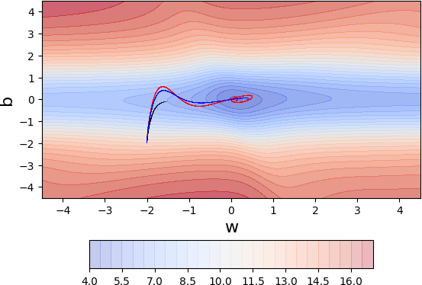
GD (black), momentum (red) and NAG (blue)
There is something interesting that these 3 al- gorithms are doing for this dataset. Can you spot it?
Initially, all three algorithms are moving mainly along the vertical (b) axis and there is very little movement along the horizontal (w) axis
Why? Because in our data, the feature corres- ponding to w is sparse and hence w undergoes very few updates ...on the other hand b is very dense and undergoes many updates
Such sparsity is very common in large neural networks containing 1000s of input features and hence we need to address it
Let’s see what Adagrad does....
79 / 89
CS7015 (Deep Learning) : Lecture 5

Slide 155

80 / 89
CS7015 (Deep Learning) : Lecture 5

Slide 156

80 / 89
CS7015 (Deep Learning) : Lecture 5

Slide 157

80 / 89
CS7015 (Deep Learning) : Lecture 5

Slide 158

80 / 89
CS7015 (Deep Learning) : Lecture 5

Slide 159
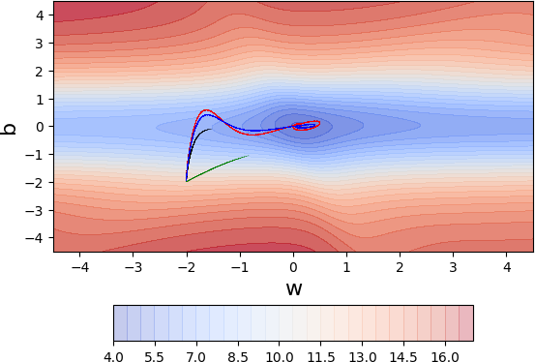
80 / 89
CS7015 (Deep Learning) : Lecture 5

Slide 160

80 / 89
CS7015 (Deep Learning) : Lecture 5

Slide 161

80 / 89
CS7015 (Deep Learning) : Lecture 5

Slide 162

80 / 89
CS7015 (Deep Learning) : Lecture 5

Slide 163

By using a parameter specific learning rate it ensures that despite sparsity w gets a higher learning rate and hence larger updates
Further, it also ensures that if b undergoes a lot of updates its effective learning rate de- creases because of the growing denominator
In practice, this does not work so well if we remove the square root from the denominator (something to ponder about)
What’s the flipside? over time the effective learning rate for b will decay to an extent that there will be no further updates to b
Can we avoid this?
80 / 89
CS7015 (Deep Learning) : Lecture 5

Slide 164
Intuition
Adagrad decays the learning rate very aggressively (as the denominator grows)
As a result after a while the frequent parameters will start receiving very small updates because of the decayed learning rate
To avoid this why not decay the denominator and prevent its rapid growth
Update rule for RMSProp
v_{t} = β ∗ v_{t−1} + (1 − β)(∇w_{t})²
η
w = w − √
∗ ∇w
t+1 t
v + E
t
t
... and a similar set of equations for b_{t}
81 / 89
CS7015 (Deep Learning) : Lecture 5

Slide 165
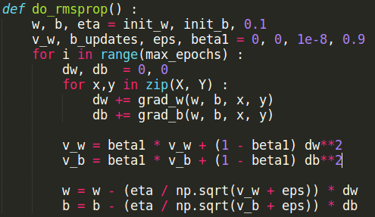

82 / 89
CS7015 (Deep Learning) : Lecture 5

Slide 166

82 / 89
CS7015 (Deep Learning) : Lecture 5

Slide 167

82 / 89
CS7015 (Deep Learning) : Lecture 5

Slide 168

82 / 89
CS7015 (Deep Learning) : Lecture 5

Slide 169

82 / 89
CS7015 (Deep Learning) : Lecture 5

Slide 170

82 / 89
CS7015 (Deep Learning) : Lecture 5

Slide 171

82 / 89
CS7015 (Deep Learning) : Lecture 5

Slide 172

82 / 89
CS7015 (Deep Learning) : Lecture 5

Slide 173

82 / 89
CS7015 (Deep Learning) : Lecture 5

Slide 174

Adagrad got stuck when it was close to convergence (it was no longer able to move in the vertical (b) direction because of the decayed learning rate)
RMSProp overcomes this problem by being less aggressive on the decay
82 / 89
CS7015 (Deep Learning) : Lecture 5

Slide 175
Intuition
Do everything that RMSProp does to solve the decay problem of Adagrad Plus use a cumulative history of the gradients
In practice, β₁ = 0.9 and β₂ = 0.999
Update rule for Adam
m_{t} = β₁ ∗ m_{t−1} + (1 − β₁) ∗ ∇w_{t} v_{t} = β₂ ∗ v_{t−1} + (1 − β₂) ∗ (∇w_{t})²
m_{t} v
mˆ = vˆ =
t
t
1 − β
t
1
t
1 − β
t
2
η
w = w − √
∗ mˆ
t+1 t
vˆ + E
t
t
... and a similar set of equations for b_{t}
83 / 89
CS7015 (Deep Learning) : Lecture 5

Slide 176


84 / 89
CS7015 (Deep Learning) : Lecture 5

Slide 177

84 / 89
CS7015 (Deep Learning) : Lecture 5

Slide 178

84 / 89
CS7015 (Deep Learning) : Lecture 5

Slide 179

84 / 89
CS7015 (Deep Learning) : Lecture 5

Slide 180

84 / 89
CS7015 (Deep Learning) : Lecture 5

Slide 181

84 / 89
CS7015 (Deep Learning) : Lecture 5

Slide 182

84 / 89
CS7015 (Deep Learning) : Lecture 5

Slide 183

84 / 89
CS7015 (Deep Learning) : Lecture 5

Slide 184

84 / 89
CS7015 (Deep Learning) : Lecture 5

Slide 185

84 / 89
CS7015 (Deep Learning) : Lecture 5

Slide 186

As expected, taking a cumulative his-
tory gives a speed up ...
84 / 89
CS7015 (Deep Learning) : Lecture 5

Slide 187
Million dollar question: Which algorithm to use in practice
Adam seems to be more or less the default choice now (β₁ = 0.9, β₂ = 0.999 and E = 1e − 8 )
Although it is supposed to be robust to initial learning rates, we have observed that for sequence generation problems η = 0.001, 0.0001 works best
Having said that, many papers report that SGD with momentum (Nesterov or classical) with a simple annealing learning rate schedule also works well in practice (typically, starting with η = 0.001, 0.0001 for sequence generation problems)
Adam might just be the best choice overall!!
Some recent work suggest that there is a problem with Adam and it will not converge in some cases
85 / 89
CS7015 (Deep Learning) : Lecture 5

